Slide 1
CS 295A/395D: Artificial Intelligence
KT45
Prof. Emma Tosch
25 March 2022

Slide 2
Logistics
Reminder: this is neither an online nor a hybrid course.
I’ve built leniency into the schedule and grading scheme.
I will support remote attendance insofar as it is convenient for me to do so. Do not rely on this being a remote course.
If you cannot attend in person, be in touch with me or Michael and come to student hours.

Slide 3

Recall: Basic modal logic syntax
$$⊤ \left| ⊥ \right| p \left| ¬φ\right| φ_{1}∧φ_{2} \left| φ_{1}∨φ_{2} \right|{ φ}_{1}→φ_{2} \left| \text{☐}φ \right| \text{◇}φ$$
p | ¬p | q ∧ p | p → q | p ∨ q
☐ p | ◇¬p | ☐(q ∧ p) | ◇(p → q) | q ∨ ☐ p
☐ ☐ p | ¬◇p | ☐q ∧ ◇p | ◇(p → ☐q) | ☐◇(q ∨ ☐ p)

Slide 4
Recall: Basic modal logic syntax
$$⊤ \left| ⊥ \right| p \left| ¬φ\right| φ_{1}∧φ_{2} \left| φ_{1}∨φ_{2} \right|{ φ}_{1}→φ_{2} \left| \text{☐}φ \right| \text{◇}φ$$
p | ¬p | q ∧ p | p → q | p ∨ q
☐ p | ◇¬p | ☐(q ∧ p) | ◇(p → q) | q ∨ ☐ p
☐ ☐ p | ¬◇p | ☐q ∧ ◇p | ◇(p → ☐q) | ☐◇(q ∨ ☐ p)

Slide 5
Recall: Basic modal logic syntax
$$⊤ \left| ⊥ \right| p \left| ¬φ\right| φ_{1}∧φ_{2} \left| φ_{1}∨φ_{2} \right|{ φ}_{1}→φ_{2} \left| \text{☐}φ \right| \text{◇}φ$$
p | ¬p | q ∧ p | p → q | p ∨ q
☐ p | ◇¬p | ☐(q ∧ p) | ◇(p → q) | q ∨ ☐ p
☐ ☐ p | ¬◇p | ☐q ∧ ◇p | ◇(p → ☐q) | ☐◇(q ∨ ☐ p)

Slide 6
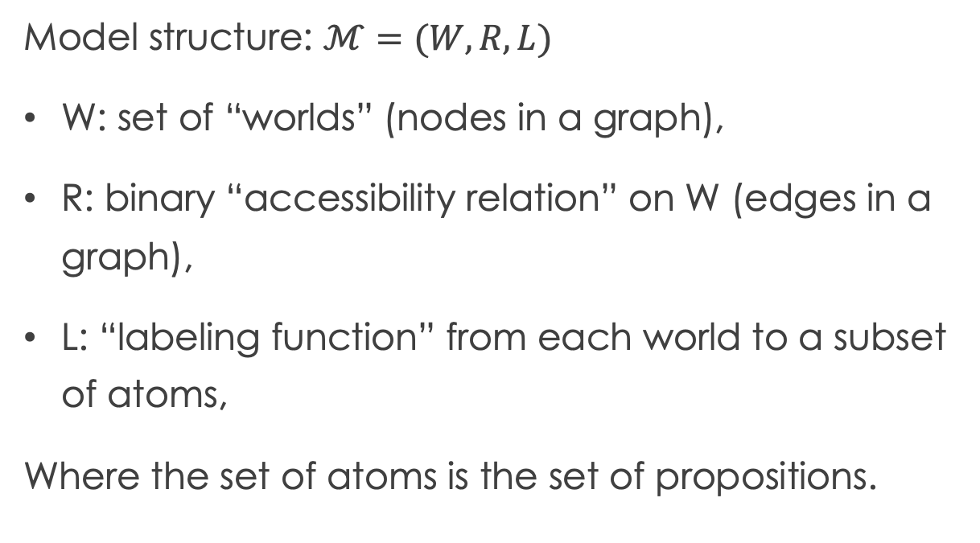
Recall: Basic modal logic semantics
Model structure: $ℳ=(W, R, L)$
W: set of “worlds” (nodes in a graph),
R: binary “accessibility relation” on W (edges in a graph),
L: “labeling function” from each world to a subset of atoms,
Where the set of atoms is the set of propositions.
w₂
P, q
w₁
q
p
w₃
w₄
p
q
w₆
w₅

Slide 7
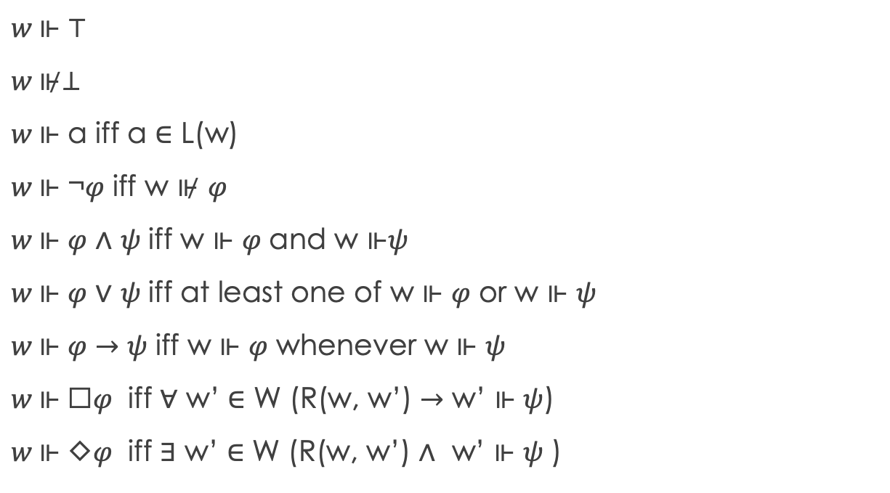
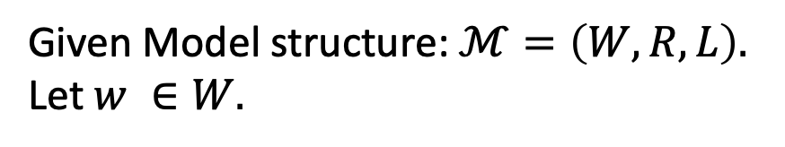
Basic modal logic: Semantics
$w \text{⊩}$ ⊤
$w \text{⊮}$⊥
$w \text{⊩}$ a iff a ∈ L(w)
$w \text{⊩}$ ¬𝜑 iff w ⊮ 𝜑
$w \text{⊩}$ 𝜑 ∧ 𝜓 iff w $\text{⊩}$ 𝜑 and w $\text{⊩}\text{ψ}$
$w \text{⊩}$ 𝜑 ∨ 𝜓 iff at least one of w $\text{⊩}$ 𝜑 or w $\text{⊩} \text{ψ}$
$w \text{⊩}$ 𝜑 $→$ 𝜓 iff w $\text{⊩}$ 𝜑 whenever w $\text{⊩ }\text{ψ}$
$w \text{⊩}$ ☐𝜑 iff ∀ w’ ∈ W (R(w, w’) $→$ w’ $\text{⊩ }\text{ψ}$)
$w \text{⊩}$ ◇𝜑 iff ∃ w’ ∈ W (R(w, w’) ∧ w’ $\text{⊩ }\text{ψ}\text{ )}$
w₂
Given Model structure: $ℳ=\left(W, R, L\right).$
Let $w ∈W.$
P, q
w₁
q
p
w₃
w₄
p
q
w₆
w₅

Slide 8
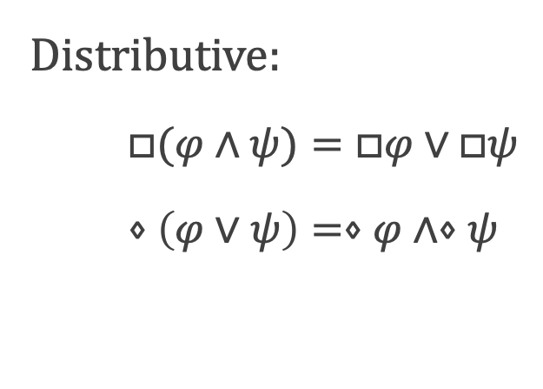
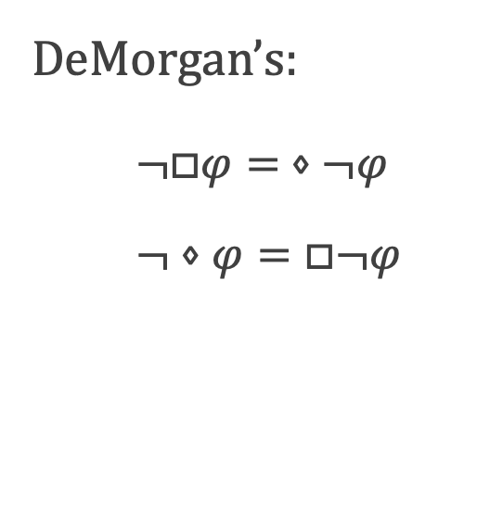
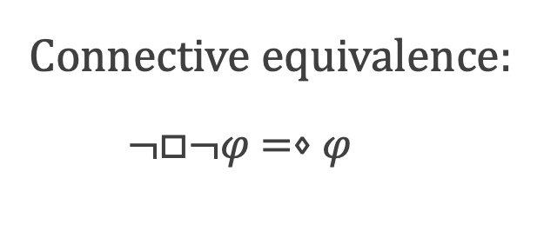
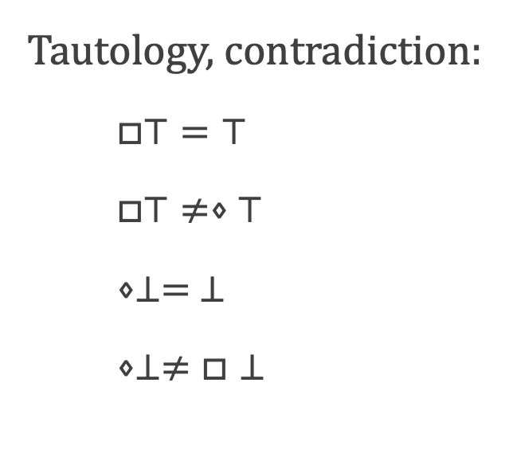
Recap: New rules/equivalences
DeMorgan’s:
$¬□φ$ $= ⋄¬φ$
$$¬⋄φ=□¬φ$$
Distributive:
$$□(φ∧ψ)=□φ∨□ψ$$
$$⋄\left(φ∨ψ\right)=⋄φ∧⋄ψ$$
Tautology, contradiction:
$$□⊤=⊤$$
$$□⊤≠⋄⊤$$
$$⋄⊥= ⊥$$
$$⋄⊥≠□⊥$$
Connective equivalence:
$$¬□¬φ =⋄φ$$

Slide 9

Recap: Basic valid formula of modal logic
All the same valid formulas, plus “K”:
$$(□(φ→ψ)∧□φ)→□ψ$$
Also written:
$$□(φ→ψ)→(□φ→□ψ)$$
Notes:
Work through why this is a tautology on the board
Derive second expression on the board

Slide 10
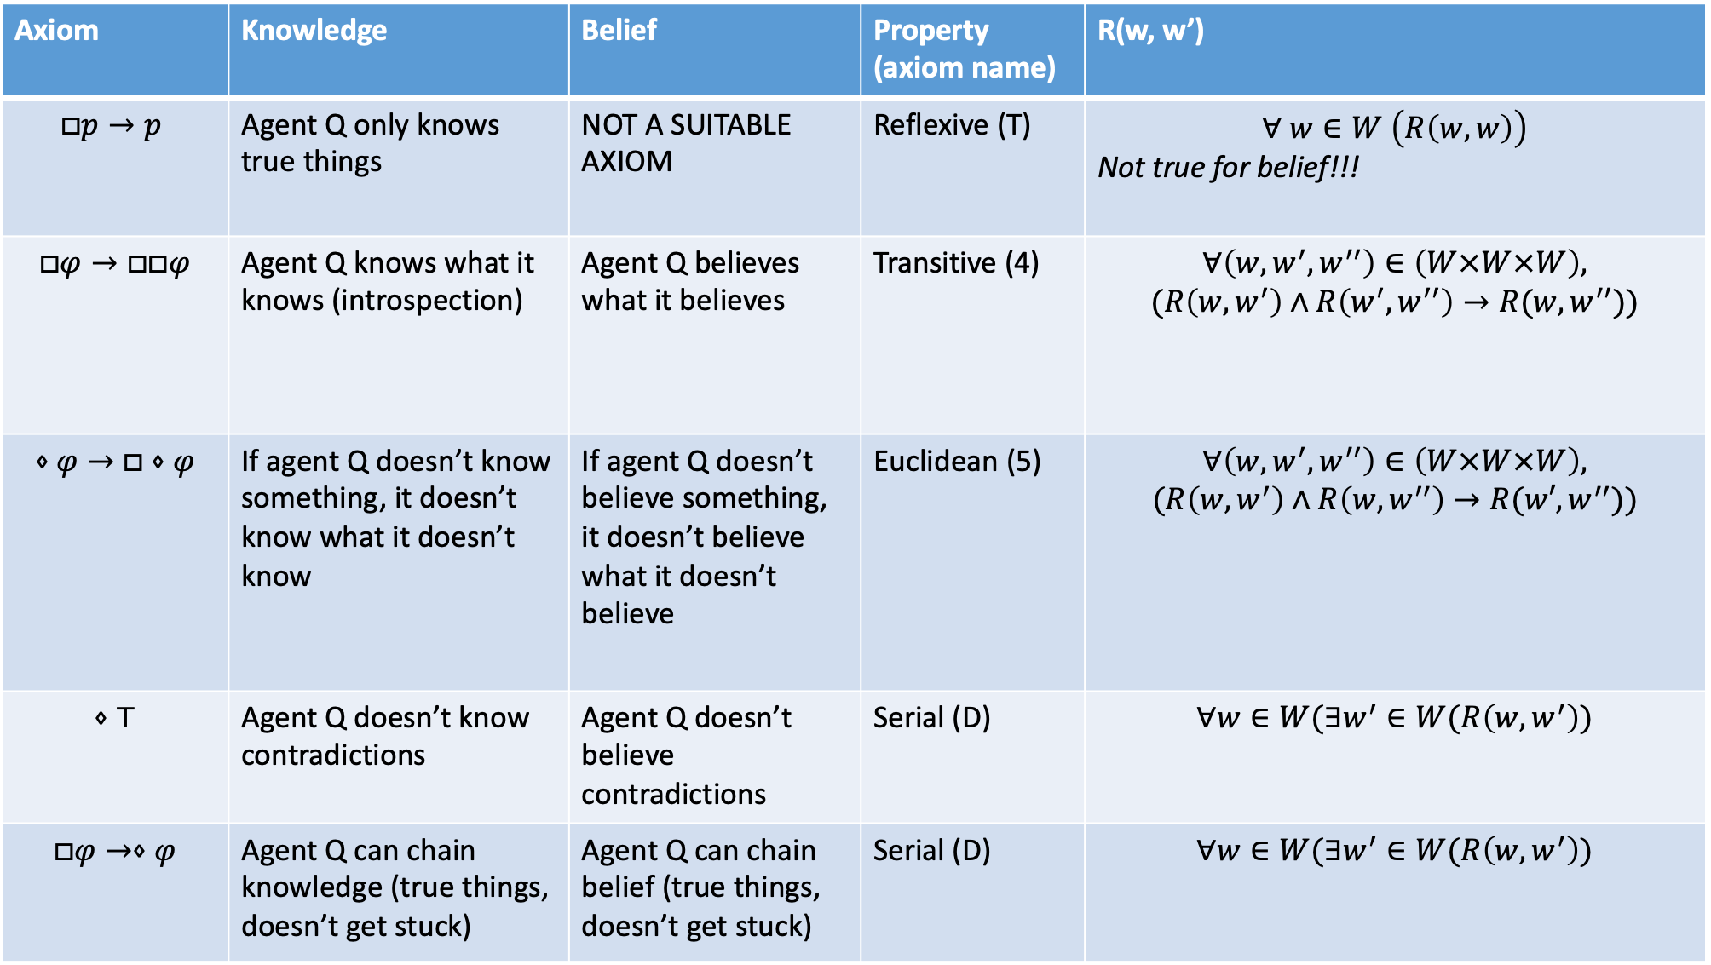
Axiom | Knowledge | Belief | Property (axiom name) | R(w, w’)
$$□p→p$$ | Agent Q only knows true things | NOT A SUITABLE AXIOM | Reflexive (T) | $$∀ w∈W \left(R\left(w, w\right)\right)$$ Not true for belief!!!
$□φ→□□φ$ | Agent Q knows what it knows (introspection) | Agent Q believes what it believes | Transitive (4) | $$∀\left(w, w^{′}, w^{′′}\right)∈\left(W×W×W\right),$$ $$(R\left(w, w^{′}\right)∧R\left(w^{′}, w^{′′}\right)→R(w, w^{′′}))$$
$$⋄φ→□⋄φ$$ | If agent Q doesn’t know something, it doesn’t know what it doesn’t know | If agent Q doesn’t believe something, it doesn’t believe what it doesn’t believe | Euclidean (5) | $$∀\left(w, w^{′}, w^{′′}\right)∈\left(W×W×W\right),$$ $$(R\left(w, w^{′}\right)∧R\left(w, w^{′′}\right)→R(w′, w^{′′}))$$
$$⋄⊤$$ | Agent Q doesn’t know contradictions | Agent Q doesn’t believe contradictions | Serial (D) | $$∀w∈W(∃w^{′}∈W(R\left(w, w^{′}\right))$$
$$□φ→⋄φ$$ | Agent Q can chain knowledge (true things, doesn’t get stuck) | Agent Q can chain belief (true things, doesn’t get stuck) | Serial (D) | $$∀w∈W(∃w^{′}∈W(R\left(w, w^{′}\right))$$
Notes:
”If agent Q knows p to be true, is p true?”

Slide 11
Graph comparison on board

Slide 12
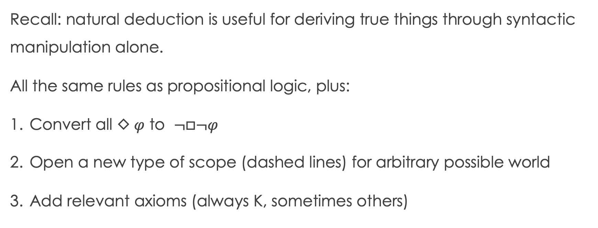
Natural deduction in modal logic
Recall: natural deduction is useful for deriving true things through syntactic manipulation alone.
All the same rules as propositional logic, plus:
Convert all $\text{◇} φ$ to $¬□¬φ$
Open a new type of scope (dashed lines) for arbitrary possible world
Add relevant axioms (always K, sometimes others)

Slide 13
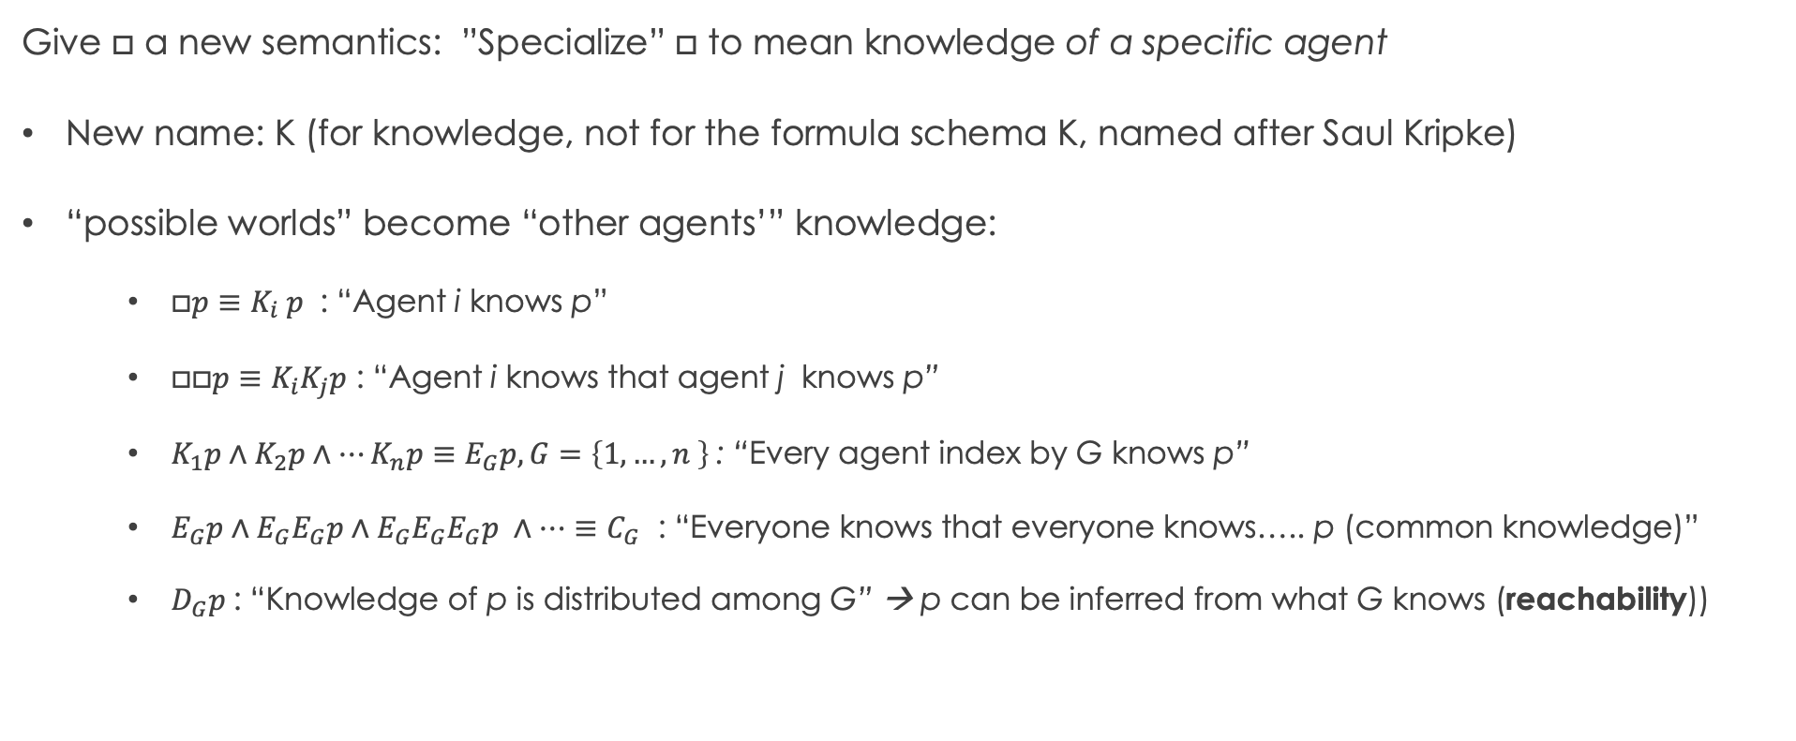
Epistemic logic engineering: S5/KT45^{n}
Give $□$ a new semantics: ”Specialize” $□$ to mean knowledge of a specific agent
New name: K (for knowledge, not for the formula schema K, named after Saul Kripke)
“possible worlds” become “other agents’” knowledge:
$□p≡K_{i} p$ : “Agent i knows p”
$□□p≡K_{i}K_{j}p$ : “Agent i knows that agent j knows p”
$K_{1}p∧K_{2}p∧…K_{n}p≡E_{G}p, G=\left\{1,…, n \right\}$: “Every agent index by G knows p”
$E_{G}p∧E_{G}E_{G}p∧E_{G}E_{G}E_{G}p ∧…≡C_{G}$ : “Everyone knows that everyone knows….. p (common knowledge)”
$D_{G}p$: “Knowledge of p is distributed among G” → p can be inferred from what G knows (reachability))

Slide 14
Basic modal logic: Semantics
$w \text{⊩}$ ⊤
$w \text{⊮}$⊥
$w \text{⊩}$ a iff a ∈ L(w)
$w \text{⊩}$ ¬𝜑 iff w ⊮ 𝜑
$w \text{⊩}$ 𝜑 ∧ 𝜓 iff w $\text{⊩}$ 𝜑 and w $\text{⊩}\text{ψ}$
$w \text{⊩}$ 𝜑 ∨ 𝜓 iff at least one of w $\text{⊩}$ 𝜑 or w $\text{⊩} \text{ψ}$
$w \text{⊩}$ 𝜑 $→$ 𝜓 iff w $\text{⊩}$ 𝜑 whenever w $\text{⊩ }\text{ψ}$
$w \text{⊩}$ ☐𝜑 iff ∀ w’ ∈ W (R(w, w’) $→$ w’ $\text{⊩ }\text{ψ}$)
$w \text{⊩}$ ◇𝜑 iff ∃ w’ ∈ W (R(w, w’) ∧ w’ $\text{⊩ }\text{ψ}\text{ )}$
w₂
Given Model structure: $ℳ=\left(W, R, L\right).$
Let $w ∈W.$
P, q
w₁
q
p
w₃
w₄
p
q
w₆
w₅

Slide 15
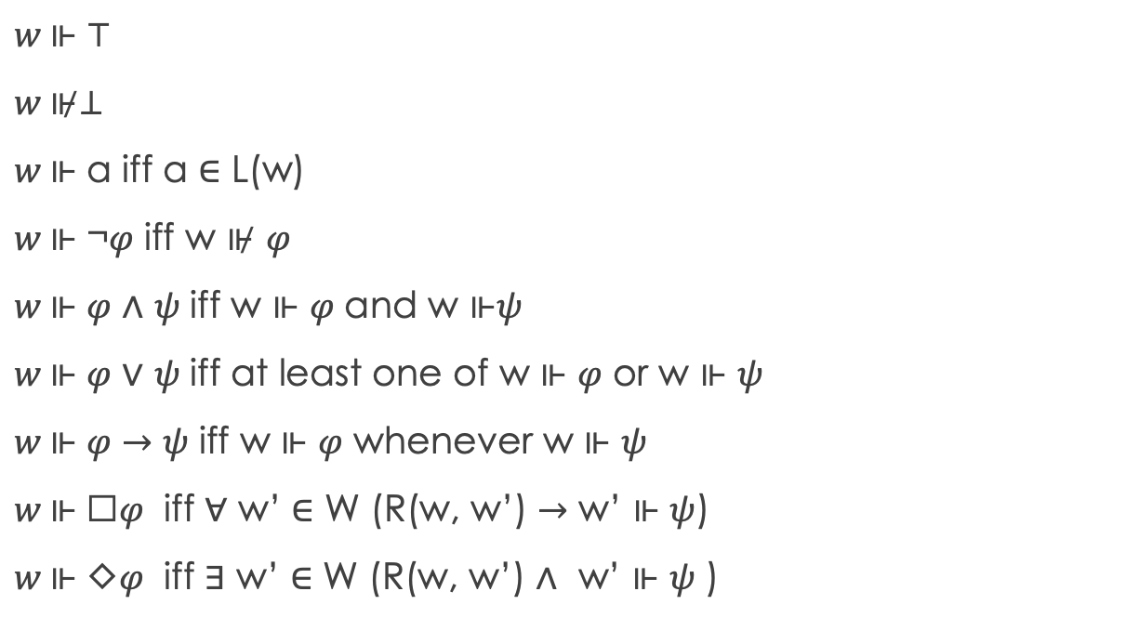

KT45^{n} syntax & Semantics
$$⊤ \left| ⊥ \right| p \left| ¬φ\right| φ_{1}∧φ_{2} \left| φ_{1}∨φ_{2} \right|{ φ}_{1}→φ_{2}$$
$$\left| {\text{K}}_{i}φ \right| E_{G}φ \left| C_{G}φ \right| D_{G}φ$$
$w \text{⊩}$ ⊤
$w \text{⊮}$⊥
$w \text{⊩}$ a iff a ∈ L(w)
$w \text{⊩}$ ¬𝜑 iff w ⊮ 𝜑
$w \text{⊩}$ 𝜑 ∧ 𝜓 iff w $\text{⊩}$ 𝜑 and w $\text{⊩}\text{ψ}$
$w \text{⊩}$ 𝜑 ∨ 𝜓 iff at least one of w $\text{⊩}$ 𝜑 or w $\text{⊩} \text{ψ}$
$w \text{⊩}$ 𝜑 $→$ 𝜓 iff w $\text{⊩}$ 𝜑 whenever w $\text{⊩ }\text{ψ}$
$w \text{⊩}$ ☐𝜑 iff ∀ w’ ∈ W (R(w, w’) $→$ w’ $\text{⊩ }\text{ψ}$)
$w \text{⊩}$ ◇𝜑 iff ∃ w’ ∈ W (R(w, w’) ∧ w’ $\text{⊩ }\text{ψ}\text{ )}$
w₂
Given Model structure: $ℳ=\left(W, R, L\right).$
Let $w ∈W.$
P, q
w₁
q
p
w₃
w₄
p
q
w₆
w₅

Slide 16
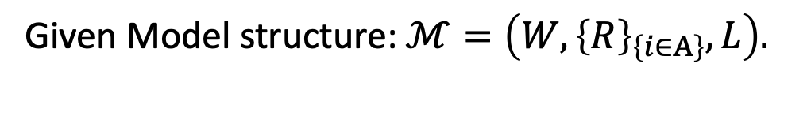
KT45^{n} syntax & Semantics
$$⊤ \left| ⊥ \right| p \left| ¬φ\right| φ_{1}∧φ_{2} \left| φ_{1}∨φ_{2} \right|{ φ}_{1}→φ_{2}$$
$$\left| {\text{K}}_{i}φ \right| E_{G}φ \left| C_{G}φ \right| D_{G}φ$$
$w \text{⊩}$ ⊤
$w \text{⊮}$⊥
$w \text{⊩}$ a iff a ∈ L(w)
$w \text{⊩}$ ¬𝜑 iff w ⊮ 𝜑
$w \text{⊩}$ 𝜑 ∧ 𝜓 iff w $\text{⊩}$ 𝜑 and w $\text{⊩}\text{ψ}$
$w \text{⊩}$ 𝜑 ∨ 𝜓 iff at least one of w $\text{⊩}$ 𝜑 or w $\text{⊩} \text{ψ}$
$w \text{⊩}$ 𝜑 $→$ 𝜓 iff w $\text{⊩}$ 𝜑 whenever w $\text{⊩ }\text{ψ}$
$w \text{⊩}$ ☐𝜑 iff ∀ w’ ∈ W (R(w, w’) $→$ w’ $\text{⊩ }\text{ψ}$)
$w \text{⊩}$ ◇𝜑 iff ∃ w’ ∈ W (R(w, w’) ∧ w’ $\text{⊩ }\text{ψ}\text{ )}$
w₂
Given Model structure: $ℳ=\left(W,{\left\{R\right\}}_{\left\{i∈A\right\}}, L\right).$
P, q
w₁
q
p
w₃
w₄
p
q
w₆
w₅

Slide 17
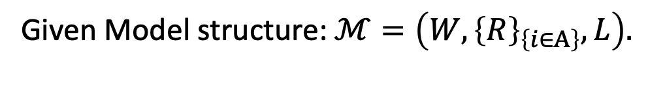
KT45^{n} syntax & Semantics
$$⊤ \left| ⊥ \right| p \left| ¬φ\right| φ_{1}∧φ_{2} \left| φ_{1}∨φ_{2} \right|{ φ}_{1}→φ_{2}$$
$$\left| {\text{K}}_{i}φ \right| E_{G}φ \left| C_{G}φ \right| D_{G}φ$$
Given Model structure: $ℳ=\left(W,{\left\{R\right\}}_{\left\{i∈A\right\}}, L\right).$
$w \text{⊩}$ ⊤
$w \text{⊮}$⊥
$w \text{⊩}$ a iff a ∈ L(w)
$w \text{⊩}$ ¬𝜑 iff w ⊮ 𝜑
$w \text{⊩}$ 𝜑 ∧ 𝜓 iff w $\text{⊩}$ 𝜑 and w $\text{⊩}\text{ψ}$
$w \text{⊩}$ 𝜑 ∨ 𝜓 iff at least one of w $\text{⊩}$ 𝜑 or w $\text{⊩} \text{ψ}$
$w \text{⊩}$ 𝜑 $→$ 𝜓 iff w $\text{⊩}$ 𝜑 whenever w $\text{⊩ }\text{ψ}$
$w \text{⊩}$ ☐𝜑 iff ∀ w’ ∈ W (R(w, w’) $→$ w’ $\text{⊩ }\text{ψ}$)
$w \text{⊩}$ ◇𝜑 iff ∃ w’ ∈ W (R(w, w’) ∧ w’ $\text{⊩ }\text{ψ}\text{ )}$
w₂
P, q
w₁
q
p
w₃
w₄
p
q
w₆
w₅

Slide 18
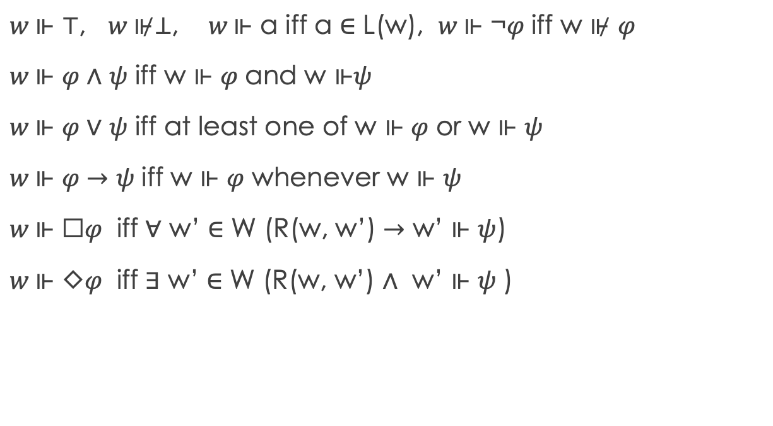
KT45^{n} syntax & Semantics
$$⊤ \left| ⊥ \right| p \left| ¬φ\right| φ_{1}∧φ_{2} \left| φ_{1}∨φ_{2} \right|{ φ}_{1}→φ_{2}$$
$$\left| {\text{K}}_{i}φ \right| E_{G}φ \left| C_{G}φ \right| D_{G}φ$$
Given Model structure: $ℳ=\left(W,{\left\{R\right\}}_{\left\{i∈A\right\}}, L\right).$
$w \text{⊩}$ ⊤, $w \text{⊮}$⊥, $w \text{⊩}$ a iff a ∈ L(w), $w \text{⊩}$ ¬𝜑 iff w ⊮ 𝜑
$w \text{⊩}$ 𝜑 ∧ 𝜓 iff w $\text{⊩}$ 𝜑 and w $\text{⊩}\text{ψ}$
$w \text{⊩}$ 𝜑 ∨ 𝜓 iff at least one of w $\text{⊩}$ 𝜑 or w $\text{⊩} \text{ψ}$
$w \text{⊩}$ 𝜑 $→$ 𝜓 iff w $\text{⊩}$ 𝜑 whenever w $\text{⊩ }\text{ψ}$
$w \text{⊩}$ ☐𝜑 iff ∀ w’ ∈ W (R(w, w’) $→$ w’ $\text{⊩ }\text{ψ}$)
$w \text{⊩}$ ◇𝜑 iff ∃ w’ ∈ W (R(w, w’) ∧ w’ $\text{⊩ }\text{ψ}\text{ )}$
w₂
P, q
w₁
q
p
w₃
w₄
p
q
w₆
w₅

Slide 19
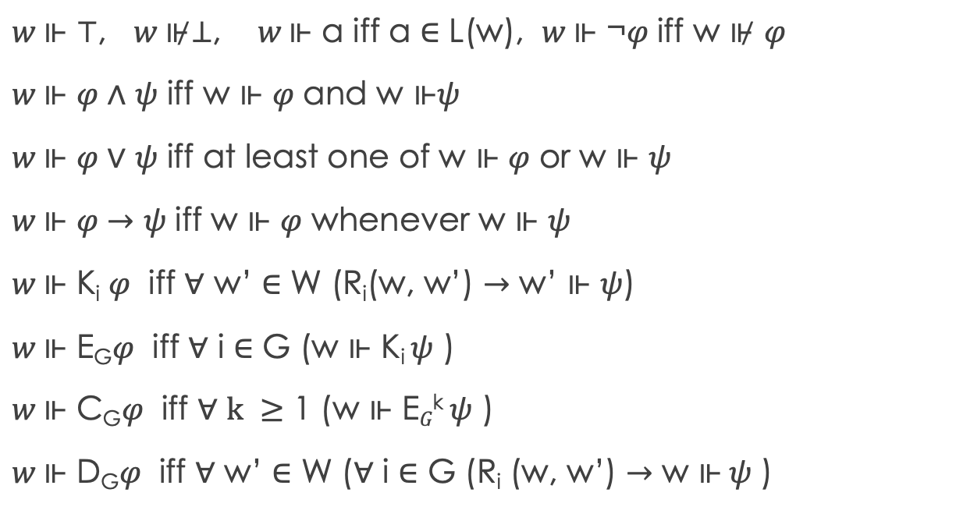
KT45^{n} syntax & Semantics
$$⊤ \left| ⊥ \right| p \left| ¬φ\right| φ_{1}∧φ_{2} \left| φ_{1}∨φ_{2} \right|{ φ}_{1}→φ_{2}$$
$$\left| {\text{K}}_{i}φ \right| E_{G}φ \left| C_{G}φ \right| D_{G}φ$$
Given Model structure: $ℳ=\left(W,{\left\{R\right\}}_{\left\{i∈A\right\}}, L\right).$
$w \text{⊩}$ ⊤, $w \text{⊮}$⊥, $w \text{⊩}$ a iff a ∈ L(w), $w \text{⊩}$ ¬𝜑 iff w ⊮ 𝜑
$w \text{⊩}$ 𝜑 ∧ 𝜓 iff w $\text{⊩}$ 𝜑 and w $\text{⊩}\text{ψ}$
$w \text{⊩}$ 𝜑 ∨ 𝜓 iff at least one of w $\text{⊩}$ 𝜑 or w $\text{⊩} \text{ψ}$
$w \text{⊩}$ 𝜑 $→$ 𝜓 iff w $\text{⊩}$ 𝜑 whenever w $\text{⊩ }\text{ψ}$
$w \text{⊩}$ K_{i} 𝜑 iff ∀ w’ ∈ W (R_{i}(w, w’) $→$ w’ $\text{⊩ }\text{ψ}$)
$w \text{⊩}$ E_{G}𝜑 iff ∀ i ∈ G (w $\text{⊩ }\text{Ki} \text{ψ}\text{ )}$
$w \text{⊩}$ C_{G}𝜑 iff ∀ $k ≥$ 1 (w $\text{⊩ }\text{E}G\text{k} \text{ψ}\text{ )}$
$w \text{⊩}$ D_{G}𝜑 iff ∀ w’ ∈ W (∀ i ∈ G (R_{i} (w, w’) $→$ w $\text{⊩} \text{ψ}\text{ )}$
w₂
P, q
w₁
q
p
w₃
w₄
p
q
w₆
w₅

Slide 20
KT45^{n} syntax & Semantics
$$⊤ \left| ⊥ \right| p \left| ¬φ\right| φ_{1}∧φ_{2} \left| φ_{1}∨φ_{2} \right|{ φ}_{1}→φ_{2}$$
$$\left| {\text{K}}_{i}φ \right| E_{G}φ \left| C_{G}φ \right| D_{G}φ$$
Given Model structure: $ℳ=\left(W,{\left\{R\right\}}_{\left\{i∈A\right\}}, L\right).$
$w \text{⊩}$ ⊤, $w \text{⊮}$⊥, $w \text{⊩}$ a iff a ∈ L(w), $w \text{⊩}$ ¬𝜑 iff w ⊮ 𝜑
$w \text{⊩}$ 𝜑 ∧ 𝜓 iff w $\text{⊩}$ 𝜑 and w $\text{⊩}\text{ψ}$
$w \text{⊩}$ 𝜑 ∨ 𝜓 iff at least one of w $\text{⊩}$ 𝜑 or w $\text{⊩} \text{ψ}$
$w \text{⊩}$ 𝜑 $→$ 𝜓 iff w $\text{⊩}$ 𝜑 whenever w $\text{⊩ }\text{ψ}$
$w \text{⊩}$ K_{i} 𝜑 iff ∀ w’ ∈ W (R_{i}(w, w’) $→$ w’ $\text{⊩ }\text{ψ}$)
$w \text{⊩}$ E_{G}𝜑 iff ∀ i ∈ G (w $\text{⊩ }\text{Ki} \text{ψ}\text{ )}$
$w \text{⊩}$ C_{G}𝜑 iff ∀ $k ≥$ 1 (w $\text{⊩ }\text{E}G\text{k} \text{ψ}\text{ )}$
$w \text{⊩}$ D_{G}𝜑 iff ∀ w’ ∈ W (∀ i ∈ G (R_{i} (w, w’) $→$ w $\text{⊩} \text{ψ}\text{ )}$
w₂
P, q
w₁
q
p
w₃
w₄
p
q
w₆
w₅
$□φ→φ$

Slide 21
KT45^{n} syntax & Semantics
$$⊤ \left| ⊥ \right| p \left| ¬φ\right| φ_{1}∧φ_{2} \left| φ_{1}∨φ_{2} \right|{ φ}_{1}→φ_{2}$$
$$\left| {\text{K}}_{i}φ \right| E_{G}φ \left| C_{G}φ \right| D_{G}φ$$
Given Model structure: $ℳ=\left(W,{\left\{R\right\}}_{\left\{i∈A\right\}}, L\right).$
$w \text{⊩}$ ⊤, $w \text{⊮}$⊥, $w \text{⊩}$ a iff a ∈ L(w), $w \text{⊩}$ ¬𝜑 iff w ⊮ 𝜑
$w \text{⊩}$ 𝜑 ∧ 𝜓 iff w $\text{⊩}$ 𝜑 and w $\text{⊩}\text{ψ}$
$w \text{⊩}$ 𝜑 ∨ 𝜓 iff at least one of w $\text{⊩}$ 𝜑 or w $\text{⊩} \text{ψ}$
$w \text{⊩}$ 𝜑 $→$ 𝜓 iff w $\text{⊩}$ 𝜑 whenever w $\text{⊩ }\text{ψ}$
$w \text{⊩}$ K_{i} 𝜑 iff ∀ w’ ∈ W (R_{i}(w, w’) $→$ w’ $\text{⊩ }\text{ψ}$)
$w \text{⊩}$ E_{G}𝜑 iff ∀ i ∈ G (w $\text{⊩ }\text{Ki} \text{ψ}\text{ )}$
$w \text{⊩}$ C_{G}𝜑 iff ∀ $k ≥$ 1 (w $\text{⊩ }\text{E}G\text{k} \text{ψ}\text{ )}$
$w \text{⊩}$ D_{G}𝜑 iff ∀ w’ ∈ W (∀ i ∈ G (R_{i} (w, w’) $→$ w $\text{⊩} \text{ψ}\text{ )}$
w₂
P, q
w₁
q
p
w₃
w₄
p
q
w₆
w₅
$$□φ→□□φ$$

Slide 22
KT45^{n} syntax & Semantics
$$⊤ \left| ⊥ \right| p \left| ¬φ\right| φ_{1}∧φ_{2} \left| φ_{1}∨φ_{2} \right|{ φ}_{1}→φ_{2}$$
$$\left| {\text{K}}_{i}φ \right| E_{G}φ \left| C_{G}φ \right| D_{G}φ$$
Given Model structure: $ℳ=\left(W,{\left\{R\right\}}_{\left\{i∈A\right\}}, L\right).$
$w \text{⊩}$ ⊤, $w \text{⊮}$⊥, $w \text{⊩}$ a iff a ∈ L(w), $w \text{⊩}$ ¬𝜑 iff w ⊮ 𝜑
$w \text{⊩}$ 𝜑 ∧ 𝜓 iff w $\text{⊩}$ 𝜑 and w $\text{⊩}\text{ψ}$
$w \text{⊩}$ 𝜑 ∨ 𝜓 iff at least one of w $\text{⊩}$ 𝜑 or w $\text{⊩} \text{ψ}$
$w \text{⊩}$ 𝜑 $→$ 𝜓 iff w $\text{⊩}$ 𝜑 whenever w $\text{⊩ }\text{ψ}$
$w \text{⊩}$ K_{i} 𝜑 iff ∀ w’ ∈ W (R_{i}(w, w’) $→$ w’ $\text{⊩ }\text{ψ}$)
$w \text{⊩}$ E_{G}𝜑 iff ∀ i ∈ G (w $\text{⊩ }\text{Ki} \text{ψ}\text{ )}$
$w \text{⊩}$ C_{G}𝜑 iff ∀ $k ≥$ 1 (w $\text{⊩ }\text{E}G\text{k} \text{ψ}\text{ )}$
$w \text{⊩}$ D_{G}𝜑 iff ∀ w’ ∈ W (∀ i ∈ G (R_{i} (w, w’) $→$ w $\text{⊩} \text{ψ}\text{ )}$
w₂
P, q
w₁
q
p
w₃
w₄
p
q
w₆
w₅
$$⋄φ→□⋄φ$$

Slide 23

KT45^{n} syntax & Semantics
$$⊤ \left| ⊥ \right| p \left| ¬φ\right| φ_{1}∧φ_{2} \left| φ_{1}∨φ_{2} \right|{ φ}_{1}→φ_{2}$$
$$\left| {\text{K}}_{i}φ \right| E_{G}φ \left| C_{G}φ \right| D_{G}φ$$
Given Model structure: $ℳ=\left(W,{\left\{R\right\}}_{\left\{i∈A\right\}}, L\right).$
$w \text{⊩}$ ⊤, $w \text{⊮}$⊥, $w \text{⊩}$ a iff a ∈ L(w), $w \text{⊩}$ ¬𝜑 iff w ⊮ 𝜑
$w \text{⊩}$ 𝜑 ∧ 𝜓 iff w $\text{⊩}$ 𝜑 and w $\text{⊩}\text{ψ}$
$w \text{⊩}$ 𝜑 ∨ 𝜓 iff at least one of w $\text{⊩}$ 𝜑 or w $\text{⊩} \text{ψ}$
$w \text{⊩}$ 𝜑 $→$ 𝜓 iff w $\text{⊩}$ 𝜑 whenever w $\text{⊩ }\text{ψ}$
$w \text{⊩}$ K_{i} 𝜑 iff ∀ w’ ∈ W (R_{i}(w, w’) $→$ w’ $\text{⊩ }\text{ψ}$)
$w \text{⊩}$ E_{G}𝜑 iff ∀ i ∈ G (w $\text{⊩ }\text{Ki} \text{ψ}\text{ )}$
$w \text{⊩}$ C_{G}𝜑 iff ∀ $k ≥$ 1 (w $\text{⊩ }\text{E}G\text{k} \text{ψ}\text{ )}$
$w \text{⊩}$ D_{G}𝜑 iff ∀ w’ ∈ W (∀ i ∈ G (R_{i} (w, w’) $→$ w $\text{⊩} \text{ψ}\text{ )}$
w₂
P, q
R₁
w₁
R₁
q
p
w₃
R₁
w₄
p
q
R₁
w₆
w₅
For what world(s) w is $w \text{⊩}$ K₁ q true?
Notes:
none

Slide 24
KT45^{n} syntax & Semantics
$$⊤ \left| ⊥ \right| p \left| ¬φ\right| φ_{1}∧φ_{2} \left| φ_{1}∨φ_{2} \right|{ φ}_{1}→φ_{2}$$
$$\left| {\text{K}}_{i}φ \right| E_{G}φ \left| C_{G}φ \right| D_{G}φ$$
Given Model structure: $ℳ=\left(W,{\left\{R\right\}}_{\left\{i∈A\right\}}, L\right).$
$w \text{⊩}$ ⊤, $w \text{⊮}$⊥, $w \text{⊩}$ a iff a ∈ L(w), $w \text{⊩}$ ¬𝜑 iff w ⊮ 𝜑
$w \text{⊩}$ 𝜑 ∧ 𝜓 iff w $\text{⊩}$ 𝜑 and w $\text{⊩}\text{ψ}$
$w \text{⊩}$ 𝜑 ∨ 𝜓 iff at least one of w $\text{⊩}$ 𝜑 or w $\text{⊩} \text{ψ}$
$w \text{⊩}$ 𝜑 $→$ 𝜓 iff w $\text{⊩}$ 𝜑 whenever w $\text{⊩ }\text{ψ}$
$w \text{⊩}$ K_{i} 𝜑 iff ∀ w’ ∈ W (R_{i}(w, w’) $→$ w’ $\text{⊩ }\text{ψ}$)
$w \text{⊩}$ E_{G}𝜑 iff ∀ i ∈ G (w $\text{⊩ }\text{Ki} \text{ψ}\text{ )}$
$w \text{⊩}$ C_{G}𝜑 iff ∀ $k ≥$ 1 (w $\text{⊩ }\text{E}G\text{k} \text{ψ}\text{ )}$
$w \text{⊩}$ D_{G}𝜑 iff ∀ w’ ∈ W (∀ i ∈ G (R_{i} (w, w’) $→$ w $\text{⊩} \text{ψ}\text{ )}$
w₂
p, q
R₁
w₁
R₁
q
p, q
w₃
R₁
w₄
p
q
R₁
w₆
w₅
For what world(s) w is $w \text{⊩}$ K₁ q true?
Notes:
W1, w1, w3,

Slide 25

KT45^{n} syntax & Semantics
$$⊤ \left| ⊥ \right| p \left| ¬φ\right| φ_{1}∧φ_{2} \left| φ_{1}∨φ_{2} \right|{ φ}_{1}→φ_{2}$$
$$\left| {\text{K}}_{i}φ \right| E_{G}φ \left| C_{G}φ \right| D_{G}φ$$
Given Model structure: $ℳ=\left(W,{\left\{R\right\}}_{\left\{i∈A\right\}}, L\right).$
$w \text{⊩}$ ⊤, $w \text{⊮}$⊥, $w \text{⊩}$ a iff a ∈ L(w), $w \text{⊩}$ ¬𝜑 iff w ⊮ 𝜑
$w \text{⊩}$ 𝜑 ∧ 𝜓 iff w $\text{⊩}$ 𝜑 and w $\text{⊩}\text{ψ}$
$w \text{⊩}$ 𝜑 ∨ 𝜓 iff at least one of w $\text{⊩}$ 𝜑 or w $\text{⊩} \text{ψ}$
$w \text{⊩}$ 𝜑 $→$ 𝜓 iff w $\text{⊩}$ 𝜑 whenever w $\text{⊩ }\text{ψ}$
$w \text{⊩}$ K_{i} 𝜑 iff ∀ w’ ∈ W (R_{i}(w, w’) $→$ w’ $\text{⊩ }\text{ψ}$)
$w \text{⊩}$ E_{G}𝜑 iff ∀ i ∈ G (w $\text{⊩ }\text{Ki} \text{ψ}\text{ )}$
$w \text{⊩}$ C_{G}𝜑 iff ∀ $k ≥$ 1 (w $\text{⊩ }\text{E}G\text{k} \text{ψ}\text{ )}$
$w \text{⊩}$ D_{G}𝜑 iff ∀ w’ ∈ W (∀ i ∈ G (R_{i} (w, w’) $→$ w $\text{⊩} \text{ψ}\text{ )}$
w₂
P, q
R₁
w₁
R₁
q
P, q
w₃
R₁
w₄
p
q
R₁
w₆
w₅
$w \text{⊩}$ E_{G} q trivially true for G = {}

Slide 26

KT45^{n} syntax & Semantics
$$⊤ \left| ⊥ \right| p \left| ¬φ\right| φ_{1}∧φ_{2} \left| φ_{1}∨φ_{2} \right|{ φ}_{1}→φ_{2}$$
$$\left| {\text{K}}_{i}φ \right| E_{G}φ \left| C_{G}φ \right| D_{G}φ$$
Given Model structure: $ℳ=\left(W,{\left\{R\right\}}_{\left\{i∈A\right\}}, L\right).$
$w \text{⊩}$ ⊤, $w \text{⊮}$⊥, $w \text{⊩}$ a iff a ∈ L(w), $w \text{⊩}$ ¬𝜑 iff w ⊮ 𝜑
$w \text{⊩}$ 𝜑 ∧ 𝜓 iff w $\text{⊩}$ 𝜑 and w $\text{⊩}\text{ψ}$
$w \text{⊩}$ 𝜑 ∨ 𝜓 iff at least one of w $\text{⊩}$ 𝜑 or w $\text{⊩} \text{ψ}$
$w \text{⊩}$ 𝜑 $→$ 𝜓 iff w $\text{⊩}$ 𝜑 whenever w $\text{⊩ }\text{ψ}$
$w \text{⊩}$ K_{i} 𝜑 iff ∀ w’ ∈ W (R_{i}(w, w’) $→$ w’ $\text{⊩ }\text{ψ}$)
$w \text{⊩}$ E_{G}𝜑 iff ∀ i ∈ G (w $\text{⊩ }\text{Ki} \text{ψ}\text{ )}$
$w \text{⊩}$ C_{G}𝜑 iff ∀ $k ≥$ 1 (w $\text{⊩ }\text{E}G\text{k} \text{ψ}\text{ )}$
$w \text{⊩}$ D_{G}𝜑 iff ∀ w’ ∈ W (∀ i ∈ G (R_{i} (w, w’) $→$ w $\text{⊩} \text{ψ}\text{ )}$
w₂
P, q
R₁
w₁
R₁
q
P, q
w₃
R₁
w₄
p
q
R₁
w₆
w₅
$w \text{⊩}$ E_{G} q true for G = {1}
Notes:
Same as previous K query

Slide 27

KT45^{n} syntax & Semantics
$$⊤ \left| ⊥ \right| p \left| ¬φ\right| φ_{1}∧φ_{2} \left| φ_{1}∨φ_{2} \right|{ φ}_{1}→φ_{2}$$
$$\left| {\text{K}}_{i}φ \right| E_{G}φ \left| C_{G}φ \right| D_{G}φ$$
Given Model structure: $ℳ=\left(W,{\left\{R\right\}}_{\left\{i∈A\right\}}, L\right).$
$w \text{⊩}$ ⊤, $w \text{⊮}$⊥, $w \text{⊩}$ a iff a ∈ L(w), $w \text{⊩}$ ¬𝜑 iff w ⊮ 𝜑
$w \text{⊩}$ 𝜑 ∧ 𝜓 iff w $\text{⊩}$ 𝜑 and w $\text{⊩}\text{ψ}$
$w \text{⊩}$ 𝜑 ∨ 𝜓 iff at least one of w $\text{⊩}$ 𝜑 or w $\text{⊩} \text{ψ}$
$w \text{⊩}$ 𝜑 $→$ 𝜓 iff w $\text{⊩}$ 𝜑 whenever w $\text{⊩ }\text{ψ}$
$w \text{⊩}$ K_{i} 𝜑 iff ∀ w’ ∈ W (R_{i}(w, w’) $→$ w’ $\text{⊩ }\text{ψ}$)
$w \text{⊩}$ E_{G}𝜑 iff ∀ i ∈ G (w $\text{⊩ }\text{Ki} \text{ψ}\text{ )}$
$w \text{⊩}$ C_{G}𝜑 iff ∀ $k ≥$ 1 (w $\text{⊩ }\text{E}G\text{k} \text{ψ}\text{ )}$
$w \text{⊩}$ D_{G}𝜑 iff ∀ w’ ∈ W (∀ i ∈ G (R_{i} (w, w’) $→$ w $\text{⊩} \text{ψ}\text{ )}$
w₂
p, q
R₁
w₁
R_{1,} R₂
q
p, q
w₃
R₁
w₄
p
q
R_{1,} R₂
w₆
w₅
For what worlds w is $w \text{⊩}$ E_{G} q true for G = {1, 2}?
Notes:
W1, W2, w3

Slide 28
KT45^{n} syntax & Semantics
$$⊤ \left| ⊥ \right| p \left| ¬φ\right| φ_{1}∧φ_{2} \left| φ_{1}∨φ_{2} \right|{ φ}_{1}→φ_{2}$$
$$\left| {\text{K}}_{i}φ \right| E_{G}φ \left| C_{G}φ \right| D_{G}φ$$
Given Model structure: $ℳ=\left(W,{\left\{R\right\}}_{\left\{i∈A\right\}}, L\right).$
$w \text{⊩}$ ⊤, $w \text{⊮}$⊥, $w \text{⊩}$ a iff a ∈ L(w), $w \text{⊩}$ ¬𝜑 iff w ⊮ 𝜑
$w \text{⊩}$ 𝜑 ∧ 𝜓 iff w $\text{⊩}$ 𝜑 and w $\text{⊩}\text{ψ}$
$w \text{⊩}$ 𝜑 ∨ 𝜓 iff at least one of w $\text{⊩}$ 𝜑 or w $\text{⊩} \text{ψ}$
$w \text{⊩}$ 𝜑 $→$ 𝜓 iff w $\text{⊩}$ 𝜑 whenever w $\text{⊩ }\text{ψ}$
$w \text{⊩}$ K_{i} 𝜑 iff ∀ w’ ∈ W (R_{i}(w, w’) $→$ w’ $\text{⊩ }\text{ψ}$)
$w \text{⊩}$ E_{G}𝜑 iff ∀ i ∈ G (w $\text{⊩ }\text{Ki} \text{ψ}\text{ )}$
$w \text{⊩}$ C_{G}𝜑 iff ∀ $k ≥$ 1 (w $\text{⊩ }\text{E}G\text{k} \text{ψ}\text{ )}$
$w \text{⊩}$ D_{G}𝜑 iff ∀ w’ ∈ W (∀ i ∈ G (R_{i} (w, w’) $→$ w $\text{⊩} \text{ψ}\text{ )}$
w₂
p, q
R₁
w₁
R_{1,} R₂
q
p, q
w₃
R₁
w₄
p
q
R_{1,} R₂
w₆
w₅
For what worlds w is $w \text{⊩}$ E_{G} E_{G} q true for G = {1, 2}?*
Notes:
W2, w3

Slide 29
KT45^{n} syntax & Semantics
$$⊤ \left| ⊥ \right| p \left| ¬φ\right| φ_{1}∧φ_{2} \left| φ_{1}∨φ_{2} \right|{ φ}_{1}→φ_{2}$$
$$\left| {\text{K}}_{i}φ \right| E_{G}φ \left| C_{G}φ \right| D_{G}φ$$
Given Model structure: $ℳ=\left(W,{\left\{R\right\}}_{\left\{i∈A\right\}}, L\right).$
$w \text{⊩}$ ⊤, $w \text{⊮}$⊥, $w \text{⊩}$ a iff a ∈ L(w), $w \text{⊩}$ ¬𝜑 iff w ⊮ 𝜑
$w \text{⊩}$ 𝜑 ∧ 𝜓 iff w $\text{⊩}$ 𝜑 and w $\text{⊩}\text{ψ}$
$w \text{⊩}$ 𝜑 ∨ 𝜓 iff at least one of w $\text{⊩}$ 𝜑 or w $\text{⊩} \text{ψ}$
$w \text{⊩}$ 𝜑 $→$ 𝜓 iff w $\text{⊩}$ 𝜑 whenever w $\text{⊩ }\text{ψ}$
$w \text{⊩}$ K_{i} 𝜑 iff ∀ w’ ∈ W (R_{i}(w, w’) $→$ w’ $\text{⊩ }\text{ψ}$)
$w \text{⊩}$ E_{G}𝜑 iff ∀ i ∈ G (w $\text{⊩ }\text{Ki} \text{ψ}\text{ )}$
$w \text{⊩}$ C_{G}𝜑 iff ∀ $k ≥$ 1 (w $\text{⊩ }\text{E}G\text{k} \text{ψ}\text{ )}$
$w \text{⊩}$ D_{G}𝜑 iff ∀ w’ ∈ W (∀ i ∈ G (R_{i} (w, w’) $→$ w $\text{⊩} \text{ψ}\text{ )}$
w₂
p, q
R_{1,} R₂
w₁
R_{1,} R₂
q
p, q
w₃
R₁
w₄
p
q
R_{1,} R₂
w₆
w₅
For what worlds w is $w \text{⊩}$ E_{G} E_{G} q true for G = {1, 2}?*
Notes:
W2, w3

Slide 30
KT45^{n} syntax & Semantics
$$⊤ \left| ⊥ \right| p \left| ¬φ\right| φ_{1}∧φ_{2} \left| φ_{1}∨φ_{2} \right|{ φ}_{1}→φ_{2}$$
$$\left| {\text{K}}_{i}φ \right| E_{G}φ \left| C_{G}φ \right| D_{G}φ$$
Given Model structure: $ℳ=\left(W,{\left\{R\right\}}_{\left\{i∈A\right\}}, L\right).$
$w \text{⊩}$ ⊤, $w \text{⊮}$⊥, $w \text{⊩}$ a iff a ∈ L(w), $w \text{⊩}$ ¬𝜑 iff w ⊮ 𝜑
$w \text{⊩}$ 𝜑 ∧ 𝜓 iff w $\text{⊩}$ 𝜑 and w $\text{⊩}\text{ψ}$
$w \text{⊩}$ 𝜑 ∨ 𝜓 iff at least one of w $\text{⊩}$ 𝜑 or w $\text{⊩} \text{ψ}$
$w \text{⊩}$ 𝜑 $→$ 𝜓 iff w $\text{⊩}$ 𝜑 whenever w $\text{⊩ }\text{ψ}$
$w \text{⊩}$ K_{i} 𝜑 iff ∀ w’ ∈ W (R_{i}(w, w’) $→$ w’ $\text{⊩ }\text{ψ}$)
$w \text{⊩}$ E_{G}𝜑 iff ∀ i ∈ G (w $\text{⊩ }\text{Ki} \text{ψ}\text{ )}$
$w \text{⊩}$ C_{G}𝜑 iff ∀ $k ≥$ 1 (w $\text{⊩ }\text{E}G\text{k} \text{ψ}\text{ )}$
$w \text{⊩}$ D_{G}𝜑 iff ∀ w’ ∈ W (∀ i ∈ G (R_{i} (w, w’) $→$ w $\text{⊩} \text{ψ}\text{ )}$
w₂
p, q
R_{1,} R₂
w₁
R_{1,} R₂
q
p, q
w₃
R₁
w₄
p
q
R_{1,} R₂
w₆
w₅
For what worlds w is $w \text{⊩}$ E_{G} E_{G} E_{G} q true for G = {1, 2}?*
Notes:
W2, w3

Slide 31
KT45^{n} syntax & Semantics
$$⊤ \left| ⊥ \right| p \left| ¬φ\right| φ_{1}∧φ_{2} \left| φ_{1}∨φ_{2} \right|{ φ}_{1}→φ_{2}$$
$$\left| {\text{K}}_{i}φ \right| E_{G}φ \left| C_{G}φ \right| D_{G}φ$$
Given Model structure: $ℳ=\left(W,{\left\{R\right\}}_{\left\{i∈A\right\}}, L\right).$
$w \text{⊩}$ ⊤, $w \text{⊮}$⊥, $w \text{⊩}$ a iff a ∈ L(w), $w \text{⊩}$ ¬𝜑 iff w ⊮ 𝜑
$w \text{⊩}$ 𝜑 ∧ 𝜓 iff w $\text{⊩}$ 𝜑 and w $\text{⊩}\text{ψ}$
$w \text{⊩}$ 𝜑 ∨ 𝜓 iff at least one of w $\text{⊩}$ 𝜑 or w $\text{⊩} \text{ψ}$
$w \text{⊩}$ 𝜑 $→$ 𝜓 iff w $\text{⊩}$ 𝜑 whenever w $\text{⊩ }\text{ψ}$
$w \text{⊩}$ K_{i} 𝜑 iff ∀ w’ ∈ W (R_{i}(w, w’) $→$ w’ $\text{⊩ }\text{ψ}$)
$w \text{⊩}$ E_{G}𝜑 iff ∀ i ∈ G (w $\text{⊩ }\text{Ki} \text{ψ}\text{ )}$
$w \text{⊩}$ C_{G}𝜑 iff ∀ $k ≥$ 1 (w $\text{⊩ }\text{E}G\text{k} \text{ψ}\text{ )}$
$w \text{⊩}$ D_{G}𝜑 iff ∀ w’ ∈ W (∀ i ∈ G (R_{i} (w, w’) $→$ w $\text{⊩} \text{ψ}\text{ )}$
w₂
p, q
R_{1,} R₂
w₁
R_{1,} R₂
q
p, q
w₃
R₁
w₄
p
q
R_{1,} R₂
w₆
w₅
For what worlds w is $w \text{⊩}$ C_{G} q true for G = {1, 2}?
Notes:
W2, w3

Slide 32
KT45^{n} syntax & Semantics
$$⊤ \left| ⊥ \right| p \left| ¬φ\right| φ_{1}∧φ_{2} \left| φ_{1}∨φ_{2} \right|{ φ}_{1}→φ_{2}$$
$$\left| {\text{K}}_{i}φ \right| E_{G}φ \left| C_{G}φ \right| D_{G}φ$$
Given Model structure: $ℳ=\left(W,{\left\{R\right\}}_{\left\{i∈A\right\}}, L\right).$
$w \text{⊩}$ ⊤, $w \text{⊮}$⊥, $w \text{⊩}$ a iff a ∈ L(w), $w \text{⊩}$ ¬𝜑 iff w ⊮ 𝜑
$w \text{⊩}$ 𝜑 ∧ 𝜓 iff w $\text{⊩}$ 𝜑 and w $\text{⊩}\text{ψ}$
$w \text{⊩}$ 𝜑 ∨ 𝜓 iff at least one of w $\text{⊩}$ 𝜑 or w $\text{⊩} \text{ψ}$
$w \text{⊩}$ 𝜑 $→$ 𝜓 iff w $\text{⊩}$ 𝜑 whenever w $\text{⊩ }\text{ψ}$
$w \text{⊩}$ K_{i} 𝜑 iff ∀ w’ ∈ W (R_{i}(w, w’) $→$ w’ $\text{⊩ }\text{ψ}$)
$w \text{⊩}$ E_{G}𝜑 iff ∀ i ∈ G (w $\text{⊩ }\text{Ki} \text{ψ}\text{ )}$
$w \text{⊩}$ C_{G}𝜑 iff ∀ $k ≥$ 1 (w $\text{⊩ }\text{E}G\text{k} \text{ψ}\text{ )}$
$w \text{⊩}$ D_{G}𝜑 iff ∀ w’ ∈ W (∀ i ∈ G (R_{i} (w, w’) $→$ w $\text{⊩} \text{ψ}\text{ )}$
w₂
p, q
R_{1,} R₂
w₁
R_{1,} R₂
q
p, q
w₃
R₁
w₄
p
q
R_{1,} R₂
w₆
w₅
For what worlds w is $w \text{⊩}$ D_{G} q true for G = {1, 2}?
Notes:
W2, w3

Slide 33
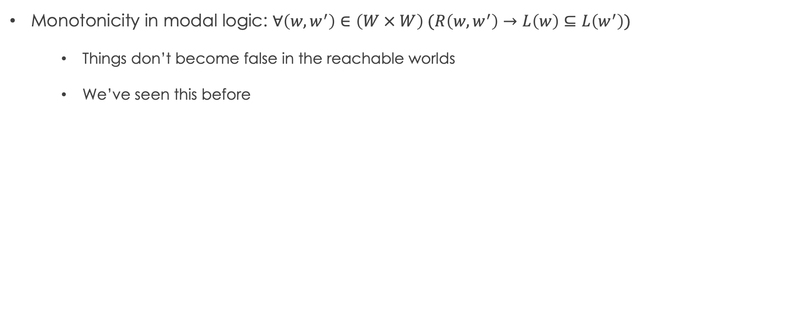
Monotonic logics
Monotonicity in modal logic: $∀\left(w, w^{′}\right)∈\left(W × W\right) (R\left(w, w^{′}\right)→L\left(w\right)⊆L\left(w^{′}\right))$
Things don’t become false in the reachable worlds
We’ve seen this before

Slide 34
Default Logic

Slide 35
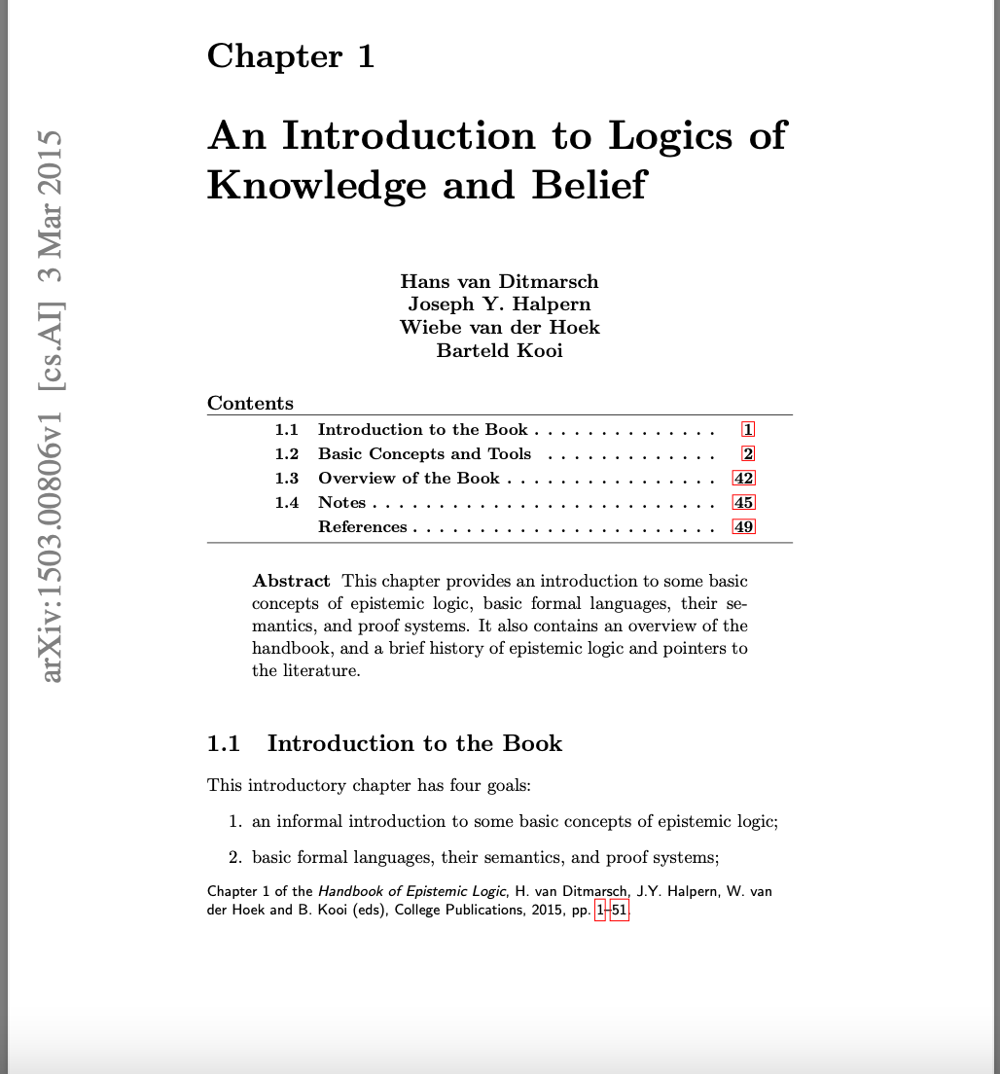
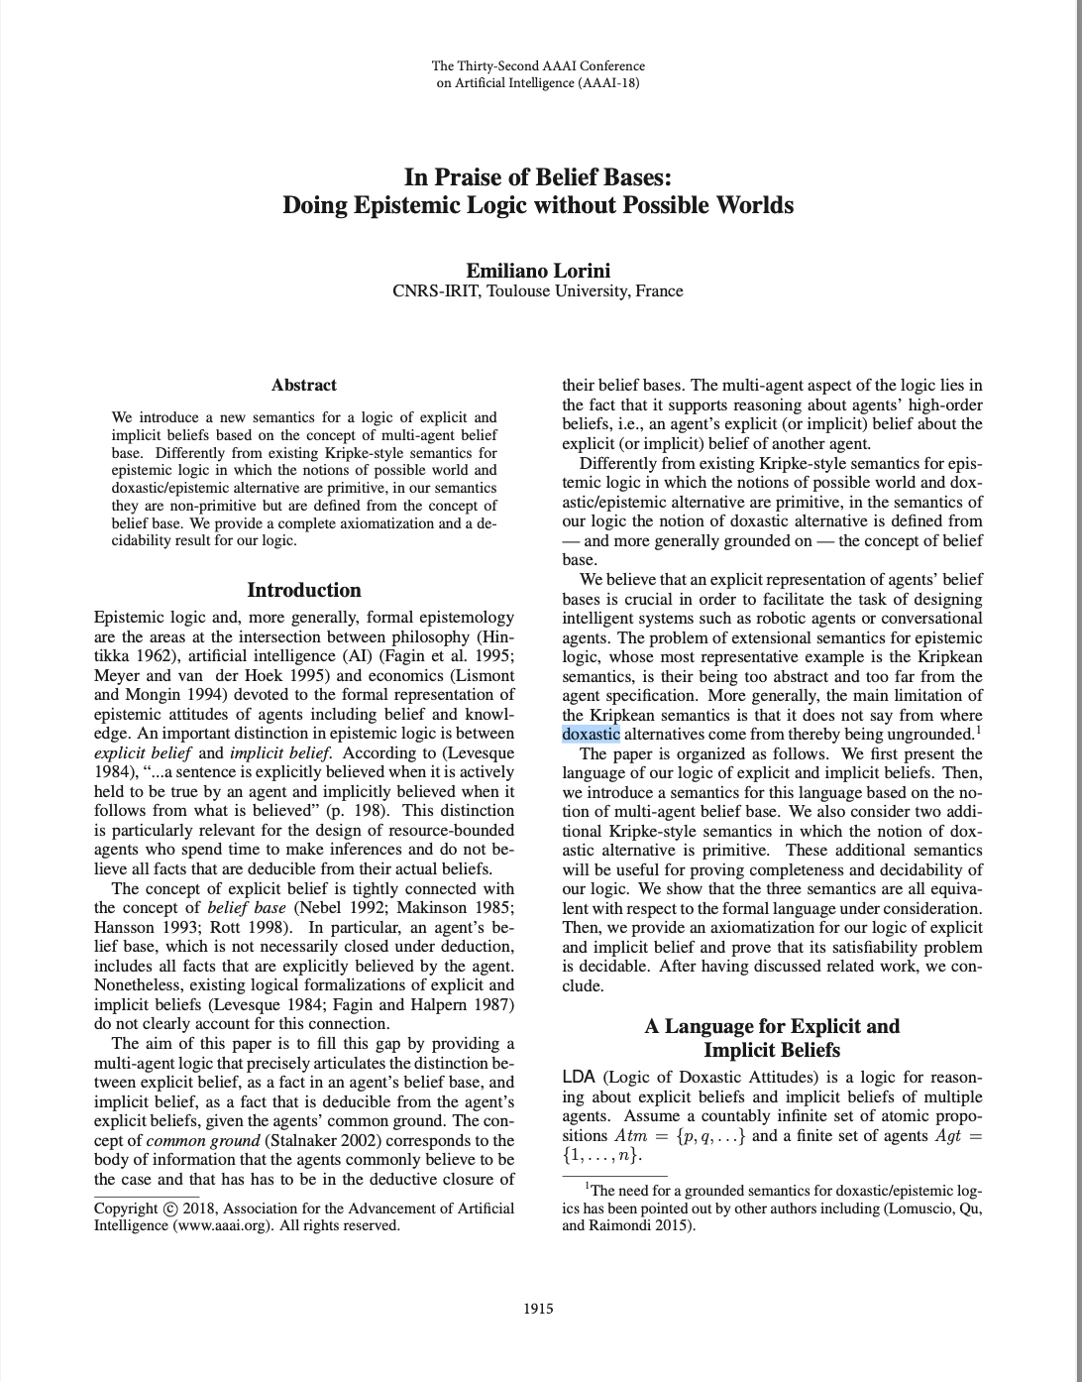

Slide 36
Exercise: CGMs vs. Kripke structures

